Slide 1

Virtualization Technologies for
Cloud Computing
Dr. Sunirmal Khatua
Presented By
Visvesvaraya Young Faculty Fellow, Govt. of India
Assistant Professor, Dept. of CSE, University of Calcutta, India

Slide 2

What is Virtualization?
Issues in Management of Physical Resource management:
provision for peak demands → overprovisioning
heterogeneity of hardware and software
machine failures
Guest OS
Guest OS
Virtualization is a basic enabler of Cloud Computing that simplifies the management of physical resources for the above three abstractions
Virtualized
Hardware
Virtualized
Hardware
Virtual Machine
Virtual Machine
A Virtual Machine (VM) is a software-based simulation of a physical computer. It runs an operating system and applications just like a real computer, but it's hosted on a physical machine (called the host) and managed by a software layer called a hypervisor.
Virtual Machine Monitor
(Hypervisor)
Host Operating System
Blade Server
Virtualization abstracts the underlying resources; simplifies their use; isolates users from one another; and supports replication which increases the elasticity of a system
Physical
Hardware

Slide 3
What is Virtualization?
Virtualization simulates the interface to a physical object by:
Multiplexing: creates multiple virtual objects from one instance of a physical object. Many virtual objects to one physical. Example - a processor is multiplexed among a number of processes or threads.
Aggregation: creates one virtual object from multiple physical objects. One virtual object to many physical objects. Example - a number of physical disks are aggregated into a RAID disk.
Emulation: constructs a virtual object of a certain type from a different type of a physical object. Example - a physical disk emulates a Random Access Memory (RAM).
Guest OS
Guest OS
Virtualized
Hardware
Virtualized
Hardware
Virtual Machine
Virtual Machine
Virtual Machine Monitor
(Hypervisor)
Host Operating System
Blade Server
Physical
Hardware

Slide 4
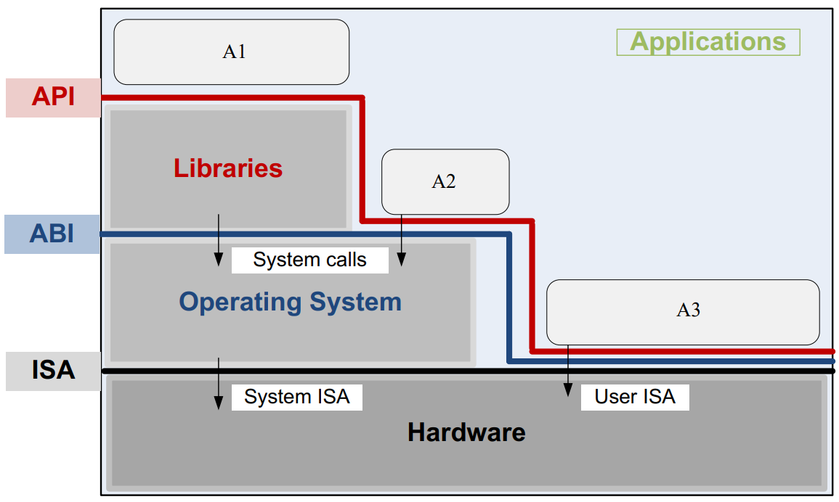
What is Virtualization?
Layers in Virtualization
Guest OS
Guest OS
Virtualized
Hardware
Virtualized
Hardware
Virtual Machine
Virtual Machine
Virtual Machine Monitor
(Hypervisor)
Host Operating System
Blade Server
Application Programming Interface (API), Application Binary Interface (ABI), and Instruction Set Architecture (ISA). An application uses library functions (A1), makes system calls (A2), and executes machine instructions (A3)
Physical
Hardware

Slide 5
Types of Hypervisor
Type 1 (bare-metal)
VM1
VM2
Hypervisor
Guest OS
Guest OS
Hardware
VMware ESX, Xen
Virtualized
Hardware
Virtualized
Hardware
Type 1 Hypervisor (bare metal, native): supports multiple virtual machines and runs directly on the hardware
Virtual Machine
Virtual Machine
Virtual Machine Monitor
(Hypervisor)
Type 2 (hosted)
VM1
VM2
Host Operating System
Process
Hypervisor
OS
Blade Server
Hardware
Physical
Hardware
VMware Workstation, KVM
Type 2 Hypervisor (hosted) VM - runs under a host operating system

Slide 6
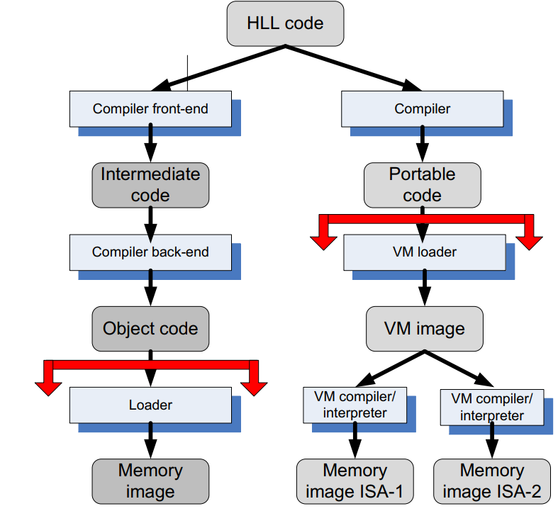
Code Portability
Binaries created by a compiler for a specific ISA and a specific operating systems are not portable
It is possible, though, to compile a HLL program for a virtual machine (VM) environment where portable code is produced and distributed and then converted by binary translators to the ISA of the host system
A dynamic binary translation converts blocks of guest instructions from the portable code to the host instruction and leads to a significant performance improvement, as such blocks are cached and reused

Slide 7
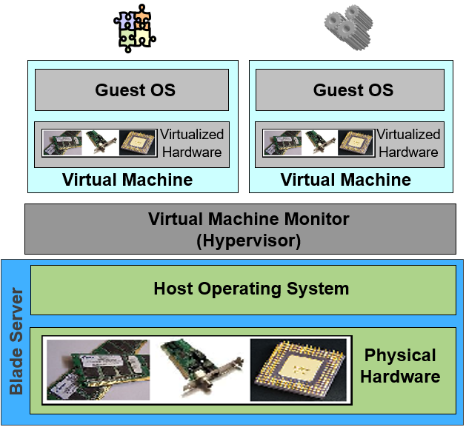
Privilege Levels and x86 Architecture
User Mode
Applications
Ring 3
Ring 2
API Call
Ring 1
Library
Ring 0
System Call
Instructions
Operating System
Instructions
Trap
Hardware
Supervisor Mode
ISSUE : How to resolve the race
among Guest OSs?

Slide 8
Solution 1: Direct Execution
Ring 3
User App
Ring 2
Direct Execution of a Guest VM
Ring 1
Guest OS
Ring 0
Hypervisor
Trap
Hardware
Problem : Every Instruction is not Virtualizable
e.g. POPF instruction will not Trap to Ring 0
ISSUE : How to resolve the race
among Guest OSs?
Solution : Full Virtualization
Paravirtualization

Slide 9
Solution 2: Full Virtualization
Ring 3
User App
Generate local trap if detected.
Ring 2
POPF (non-virtualizable instruction)
Ring 1
Guest OS
VM Code
Ring 0
Hypervisor
Scan
Trap
Binary Translation
Hardware
Translation Cache
Problems : Binary Translation is complex
Poor performance due to binary translation
ISSUE : How to resolve the race
among Guest OSs?
Solution : Dynamic Binary Translation (Soft ware Assisted full virt..
Hardware Assisted Full Virtualization :Intel-VT & AMD-V
Trap everything. Changes hardware

Slide 10
Solution 3: Paravirtualization
Ring 3
User App
Ring 2
Ring 1
Ring 0
Guest OS
Hypercall
Hypervisor
Modify the kernel to
Every system call to
hypercall
Trap
Hardware
Pros : Fast, no binary translation, no context switch(user mode to super mode , vice versa.)
Cons : Guest OS needs to be modified
ISSUE : How to resolve the race
among Guest OSs?

Slide 11
Thank You for Listening
Questions?

